Slide 1
Machine Learning CS584
"Fortune's Origin: Machine Learning Insights into Self-Made Versus Inherited Billionaire Wealth“
An Interim Report
by
Indrajit Ghosh
Rafail Mahammadli
Notes:
Source: https://www.templateswise.com/machine-learning-powerpoint-template/

Slide 2
"Fortune's Origin: Machine Learning Insights into Self-Made Versus Inherited Billionaire Wealth"
Brief Introduction:
Exploring the origins of billionaires' wealth offers more than just insight into personal success; it reflects broader economic and social patterns. Distinguishing between self-made and inherited fortunes reveals key aspects of global wealth distribution and the impact of factors like economic policies and entrepreneurship. This project delves into these dynamics, seeking a deeper understanding of wealth creation and inheritance.
Overview of Machine Learning's Role:
This project employs machine learning to address a key classification challenge: differentiating self-made billionaires from those with inherited wealth. By using ML capabilities in pattern recognition and predictive analytics, we aim to identify crucial features within complex data, offering a detailed, data-driven perspective on the origins of billionaire wealth. This approach not only simplifies the classification task but also provides statistically robust insights into the dynamics of wealth creation and inheritance.

Slide 3
Dataset Analysis Performed
Dataset Introduction:
Dataset Name: "Billionaires Statistics Data Set 2023."
Content Overview: This dataset offers an in-depth view of global billionaires, encompassing wealth details, personal demographics, and business sectors. It serves as a comprehensive resource for understanding wealth distribution and the economic and demographic profiles of the world's wealthiest individuals. Total 2640 records and 35 features.
Key Features:
Rank and Wealth: Billionaires' ranking and net worth in millions of USD.
Personal Details: Information like name, age, nationality.
Business Sectors: Includes diverse categories such as Technology, Automotive, Fashion, and retail, and details about the sources of wealth.
Country-Specific Data: Economic indicators like GDP, education rates, life expectancy, tax data, and population for each billionaire's country.
Geographical Coordinates: Latitude and longitude of each country for geographic analyses.
Data Preprocessing steps performed on the dataset:
Statistical analysis of dataset features including mean, max, and standard deviation.
Removal of irrelevant/duplicate columns and handling of missing data using forward fill and mode methods.
Data type validation and conversion (e.g., updating date formats, converting mixed datatypes like country GDP values to float).
Implementing Z-score to identify and remove outliers (reduced data from 2,640 to 2,395 records).

Slide 4
Dataset insights & EDA
Distribution Analysis
Diverse Data Points
Correlation Findings
Histograms based on probability density and box plots focused on distinguishing self-made billionaires from those who inherited their wealth.
Analyses included variables like age, birth details, country's CPI, GDP, education levels, life expectancy, tax rates, and geographical coordinates.
Generation of correlation graphs to identify relationships between variables and the target variable (self-made wealth status).

Slide 5
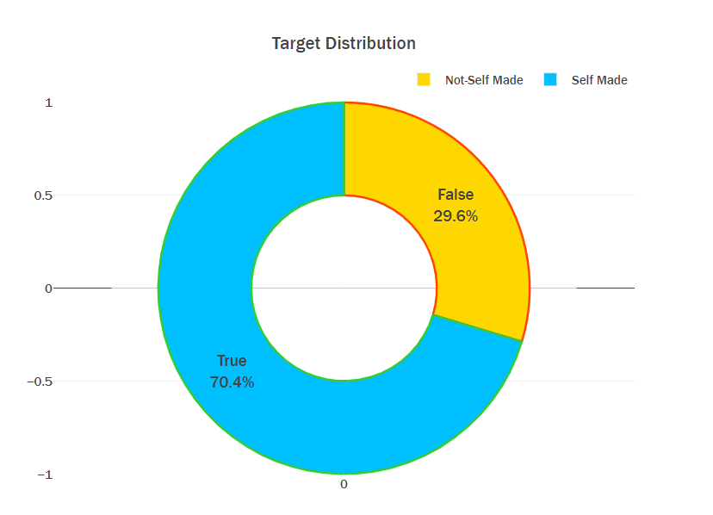
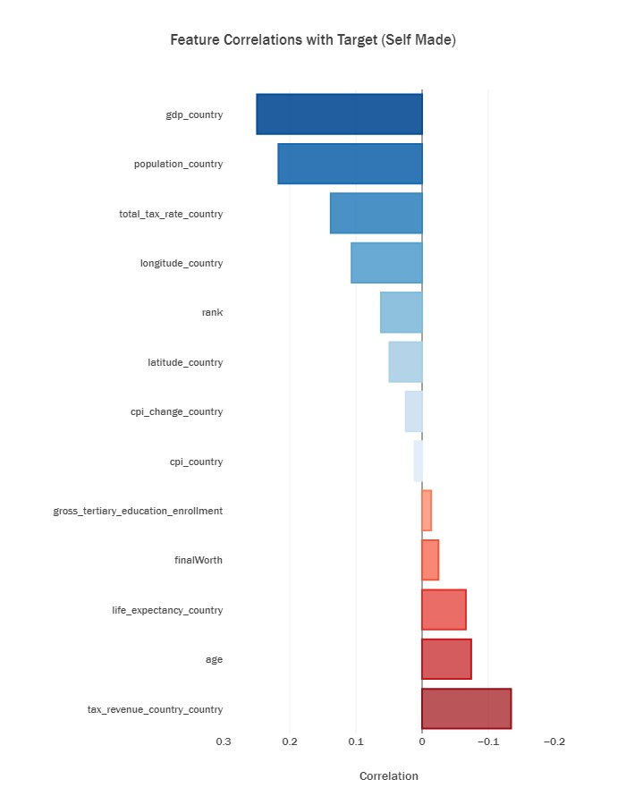
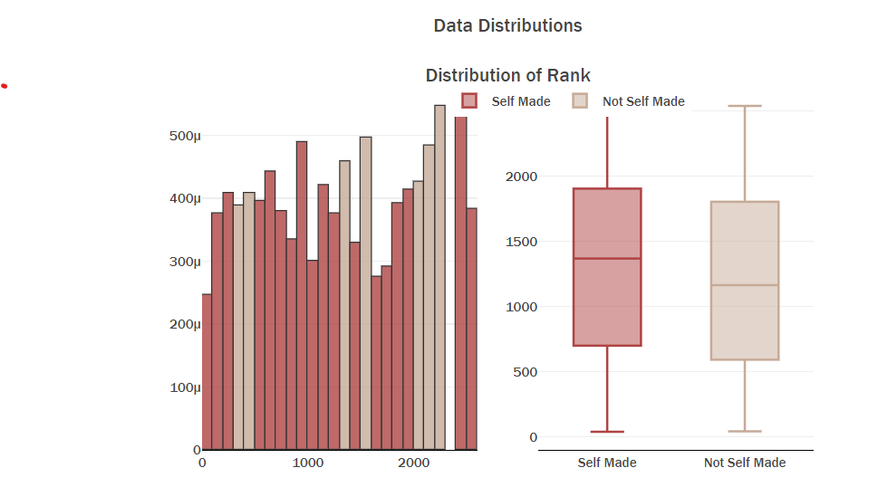
Some Visualizations based on the data Insight

Slide 6
Currently working on
Identifying Cross-Validation Strategy:
Determining the most suitable cross-validation strategy to ensure reliable model evaluation.
Initial Model Selection and Testing:
Start with a logistic regression model for classification, using all available features without initial feature removal.
Evaluate the model's performance.
Feature Engineering and Model Reassessment:
Implement feature engineering to refine the model inputs.
Retrain the logistic regression model with the new features.
Re-evaluate the model performance to assess improvements.
Testing with More Complex Models:
Experiment with advanced classifiers like Support Vector Machine (SVM) and Random Forest classifiers.
Compare the performance of these models against the logistic regression model.
Model Selection Based on Comparative Analysis:
Choose the best-performing model based on F1 scores
Hyperparameter Tuning and Optimization:
Fine-tune the selected model’s hyperparameters to optimize the performance
Conduct checks to prevent overfitting and ensure model generalizability.

Slide 7

THANK YOU

